Slide 1

Locadora De Filmes VHS
Thiago brito
Michelle nunes
Geraldo vogel
Diego Martins

Slide 2
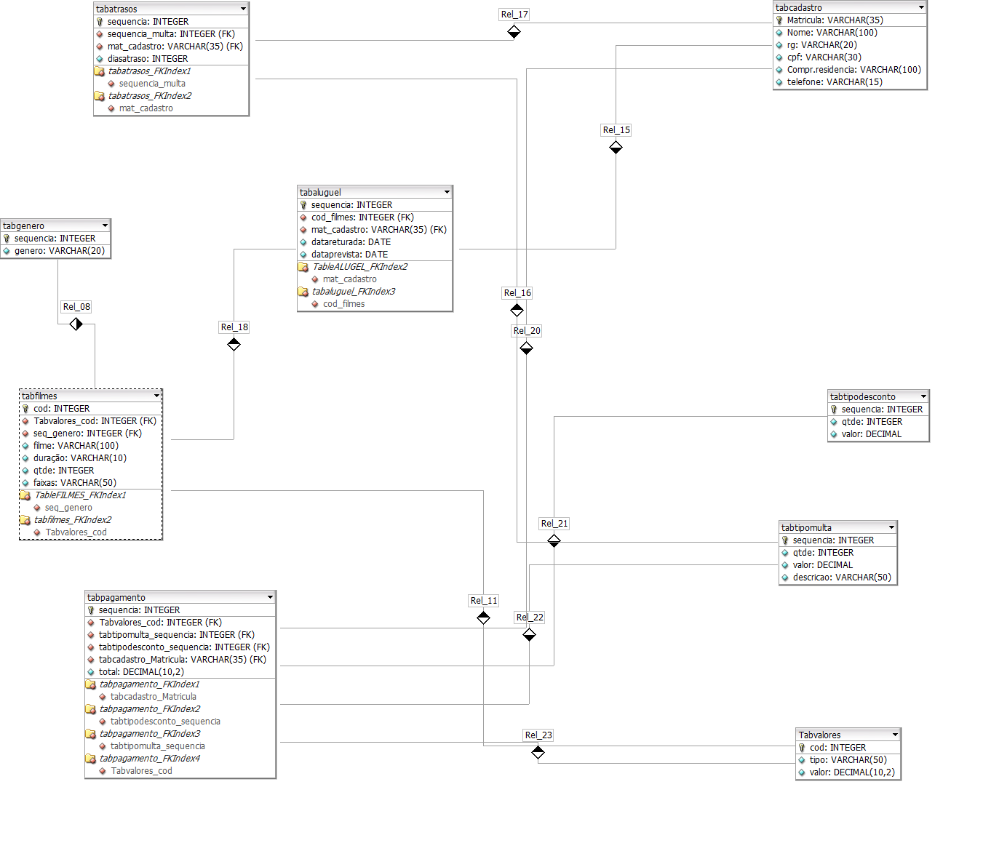

Slide 3
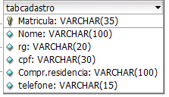
CREATE TABLE tabcadastro(
matricula varchar(35) not null,
nome varchar(100),
rg varchar(20),
cpf varchar(14),
comp_residencia varchar (100),
telefone varchar(15),
PRIMARY KEY (matricula));

Slide 4

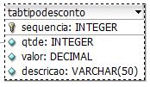
CREATE TABLE tabgenero(
sequencia integer not null,
genero varchar(20),
PRIMARY KEY (sequencia));
CREATE TABLE tabtipodesconto(
sequencia integer not null,
qtde integer,
valor decimal(10,2),
descricao varchar(50),
PRIMARY KEY (sequencia));

Slide 5
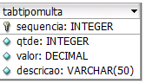

CREATE TABLE tabtipomulta(
sequencia integer not null,
descricao varchar(50),
valor decimal(10,2),
PRIMARY KEY (sequencia));
CREATE TABLE tabvalores(
cod integer not null,
tipo varchar(50),
valor decimal(10,2),
PRIMARY KEY (cod));

Slide 6
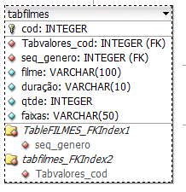
CREATE TABLE tabfilmes(
cod integer not null,
seq_genero integer not null REFERENCES tabgenero(sequencia) ON UPDATE CASCADE ON DELETE RESTRICT,
cod_valores integer not null REFERENCES tabvalores(cod) ON UPDATE CASCADE ON DELETE RESTRICT,
filme varchar(100),
faixa varchar(20),
duracao varchar(10),
qtde integer,
PRIMARY KEY (cod));

Slide 7
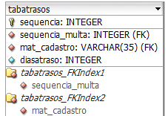
CREATE TABLE tabatrasos(
sequencia integer not null,
seq_multa integer not null REFERENCES tabtipomulta(sequencia) ON UPDATE CASCADE ON DELETE RESTRICT,
mat_cadastro varchar(35) not null REFERENCES tabcadastro(matricula) ON UPDATE CASCADE ON DELETE RESTRICT,
diasatraso integer,
PRIMARY KEY(sequencia));

Slide 8
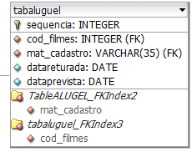
CREATE TABLE tabaluguel(
sequencia integer not null,
seq_tipodesconto integer not null REFERENCES tabtipodesconto(sequencia) ON UPDATE CASCADE ON DELETE RESTRICT,
cod_filmes integer not null REFERENCES tabfilmes(cod) ON UPDATE CASCADE ON DELETE RESTRICT,
mat_cadastro varchar(35) not null REFERENCES tabcadastro(matricula) ON UPDATE CASCADE ON DELETE RESTRICT,
data_retirada date,
data_prevista date,
PRIMARY KEY(sequencia));

Slide 9
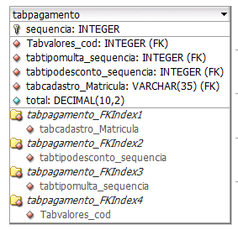
CREATE TABLE tabpagamento(
sequencia integer not null,
mat_cadastro varchar(35) not null REFERENCES tabcadastro(matricula) ON UPDATE CASCADE ON DELETE RESTRICT,
seq_multa integer not null REFERENCES tabtipomulta(sequencia) ON UPDATE CASCADE ON DELETE RESTRICT,
seq_tipodesconto integer not null REFERENCES tabtipodesconto(sequencia) ON UPDATE CASCADE ON DELETE RESTRICT,
cod_valores integer not null REFERENCES tabvalores(cod) ON UPDATE CASCADE ON DELETE RESTRICT,
PRIMARY KEY(sequencia));

